Slide 1
[INSTITUTE NAME]
Department of Computer Science and Engineering
Academic Year 2026-2027
B. Tech IV Year/I Semester
GR22A4082-Project Work Phase-1
REVIEW-3
[ Logo ]
EdgeLegal: Privacy-Preserving Contract Analysis
& Contradiction Detection
Batch No: C7
Guide Name: [Guide Name]
Designation: [Designation]
[Student Name] - [Roll No.]
[Student Name] - [Roll No.]
[Student Name] - [Roll No.]
[Student Name] - [Roll No.]

Slide 2
Project Overview & Objectives
Project Overview:
Reviewing a contract means checking whether it says something, says the opposite, or does not mention it at all.
Doing this with only a large LLM is slow and costly, and the contract has to be sent to the cloud.
In our system a small trained model (DeBERTa) answers first.
Only the cases where it is not sure (confidence below 0.95) go to the LLM.
We test this on ContractNLI, which has 607 NDAs and 17 fixed questions.
Project Objectives:
Build a two step system: a small classifier first, the LLM only when needed.
Find the right clauses of a contract using embeddings and ChromaDB.
Decide when to trust the classifier using one fixed confidence threshold.
Measure accuracy, calibration (ECE) and how many LLM calls are saved.
In phase 1 we check one clause against one question; contradictions between clauses come later.

Slide 3
System Architecture & Overall Design
Contract + question
one of the 17 fixed questions
Working Methodology / System Flow:
1. Upload - the PDF is read and split into clauses.
2. Index - each clause is embedded with bge-small-en and saved in ChromaDB.
3. Retrieve - for each of the 17 questions the closest clauses are fetched. A gap filter drops clauses that are much farther than the best one.
4. Classify - DeBERTa says Entailment, Contradiction or NotMentioned and gives a confidence.
5. Route - a LangGraph flow checks if the confidence is at least 0.95.
6. Escalate - if it is lower, the LLM reads the same clauses and decides.
7. Report - the label, confidence, evidence clause and which engine answered are saved and shown.
8. Compare - config A (LLM only), B (ready-made NLI model) and C (our fine-tuned model) are run on the same data with the same threshold.
Right now the LLM is gpt-oss-20b on Groq. We plan to move to a local model, so the privacy claim is complete only after that.
Clause extraction
PyMuPDF and clause parser
Embeddings + vector store
bge-small-en, ChromaDB
Retrieval + gap filter
keep clauses close to the best one
Step 1: DeBERTa-v3-base
label + confidence
Accept
DeBERTa label,
no LLM call
Confidence
≥ 0.95 ?
Below 0.95
Step 2: LLM reads
the same clauses
Output: label, confidence, evidence clause, engine used
saved in SQLite history and shown in the React app

Slide 4
Module-wise Breakdown
1. Training pipeline - fine-tunes DeBERTa-v3-base on ContractNLI and saves the best model.
2. Retrieval - embeds clauses with bge-small-en, stores them in ChromaDB and filters weak matches.
3. Triage classifier - gives a label and a confidence for every clause and question.
4. Agent graph - LangGraph flow: retrieve, classify, check confidence, then accept or call the LLM.
5. LLM layer - uses Groq for now (with key rotation); a local model is planned.
6. FastAPI backend - upload, analyze, history, analytics and research endpoints, with SQLite for storage.
7. Experiment runner - runs configs A, B and C and gives accuracy, macro-F1, ECE and McNemar.
8. Frontend - React and TypeScript with Landing, App, History, Analytics and Research pages.
How the modules interact
Retrieval (2)
relevant clauses
Classifier (3)
label + confidence
Agent graph (4)
accept or escalate
LLM layer (5)
hard cases only
Backend + UI (6, 8)
report and history
Module 1 gives the trained model that module 3 loads. Every clause and question goes through modules 2 to 5, and module 6 saves the result. Module 7 runs the same path on the test data to compare the three configs. Modules 1 to 6 are working. Module 7 has only been run on small samples so far.

Slide 5
Data / Input Processing
Input received
Data collection
Cleaning
Transformation
Passed on
Contract PDF (uploaded)
17 fixed questions
ContractNLI JSON: train, dev, test
Gold labels and evidence spans
607 NDAs, 17 questions each
423 train, 61 dev, 123 test
Test split has 2,091 pairs
Evidence spans for E and C labels
Text read with PyMuPDF
Split into clauses
Page and heading saved for each clause
Files other than PDF are rejected
Clauses embedded (bge-small-en)
Saved per document in ChromaDB
Gap filter removes weak clauses
Question and clauses tokenized
DeBERTa gives label and confidence
Below 0.95: LLM gets the clauses
Report saved in SQLite
Run results saved as JSON
Data flow for one contract and one question
Contract
PDF
Clauses
Embeddings
+ ChromaDB
Retrieved
clauses
DeBERTa
label + conf.
Gate
≥ 0.95 ?
Accept or
LLM
During training the model gets the marked evidence as input. When we actually use it, it only sees the clauses that retrieval gives.
This is a problem. NotMentioned examples were trained against the whole document, but live the model sees only a few clauses. We think this is why live accuracy drops, and we plan to retrain with realistic inputs.

Slide 6
Core Algorithm / Working Logic
Step-by-step working
1. Retrieve: get the closest clauses; the gap filter keeps only those within 1.15 × the best distance.
2. Classify: DeBERTa reads the question and clauses and gives a probability for each label.
3. Confidence: conf is the highest probability; the label is the one that has it.
4. Gate: if conf ≥ 0.95 we accept it, no LLM call.
5. Escalate: if conf < 0.95 the LLM reads the same clauses and decides.
6. Record: label, confidence, engine and evidence are saved for the report.
7. Evaluate: accuracy, macro-F1, ECE and the McNemar test between configs.
for (contract, hypothesis) in pairs:
clauses = retrieve(contract, hypothesis)
p = softmax(deberta(hypothesis, clauses))
conf = max(p)
if conf >= TAU: # TAU = 0.95
label = argmax(p) # accept
engine = "classifier"
else:
label = llm(hypothesis, clauses)
engine = "llm"
record(label, conf, engine)
Gate = accept if confidence ≥ 0.95, otherwise send to the LLM
ECE: group the predictions by confidence, then compare the average confidence with the real accuracy in each group. A small ECE means “95% sure” is right about 95% of the time.
McNemar test: compares two configs on the same pairs, using only the pairs where exactly one of them is right. χ² = (|b − c| − 1)² / (b + c)
Calibration checks if the probabilities are honest. Discrimination (AUROC) checks if high confidence really separates right answers from wrong ones. A good gate needs both.

Slide 7
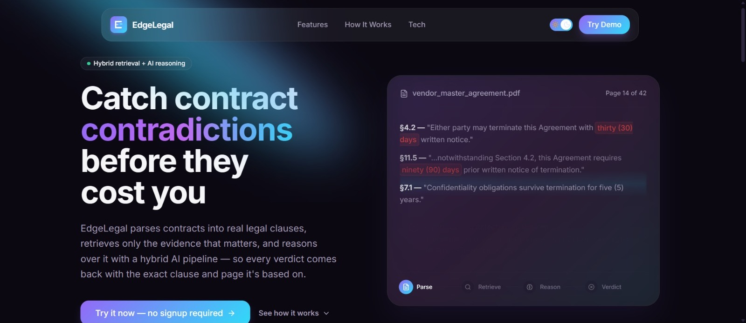
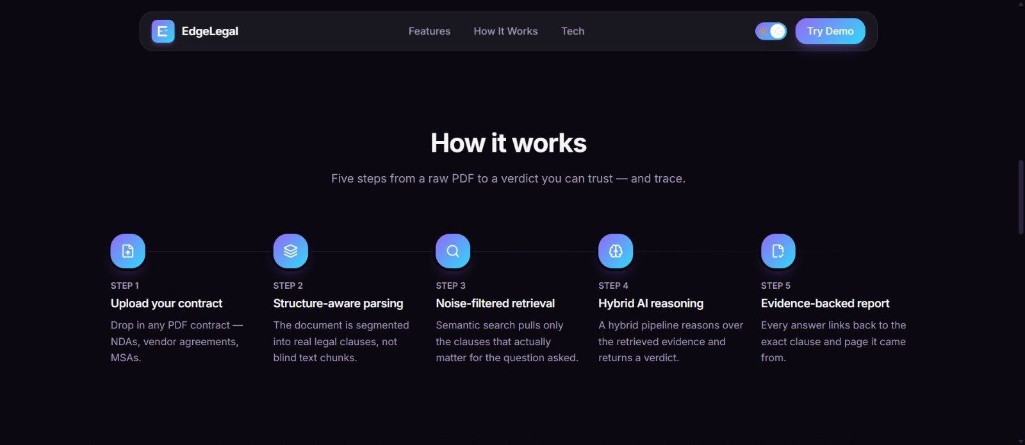
Interface & UI/UX (1/3)
Landing page
It explains the problem: manual review is slow and sending every clause to an LLM does not scale.
It shows the five steps from uploading a PDF to a report where every answer points back to a clause and page.
The Try Demo button opens the app directly, no signup is needed.
The card on the first screen is an example of what a result looks like. There is also a light and dark theme switch.
Landing page
Landing page: how it works

Slide 8
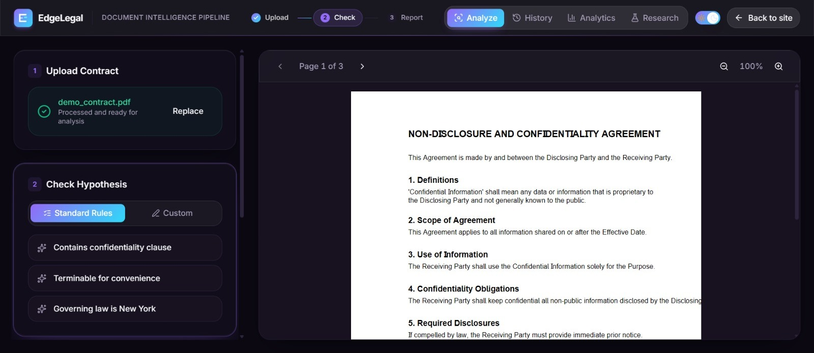
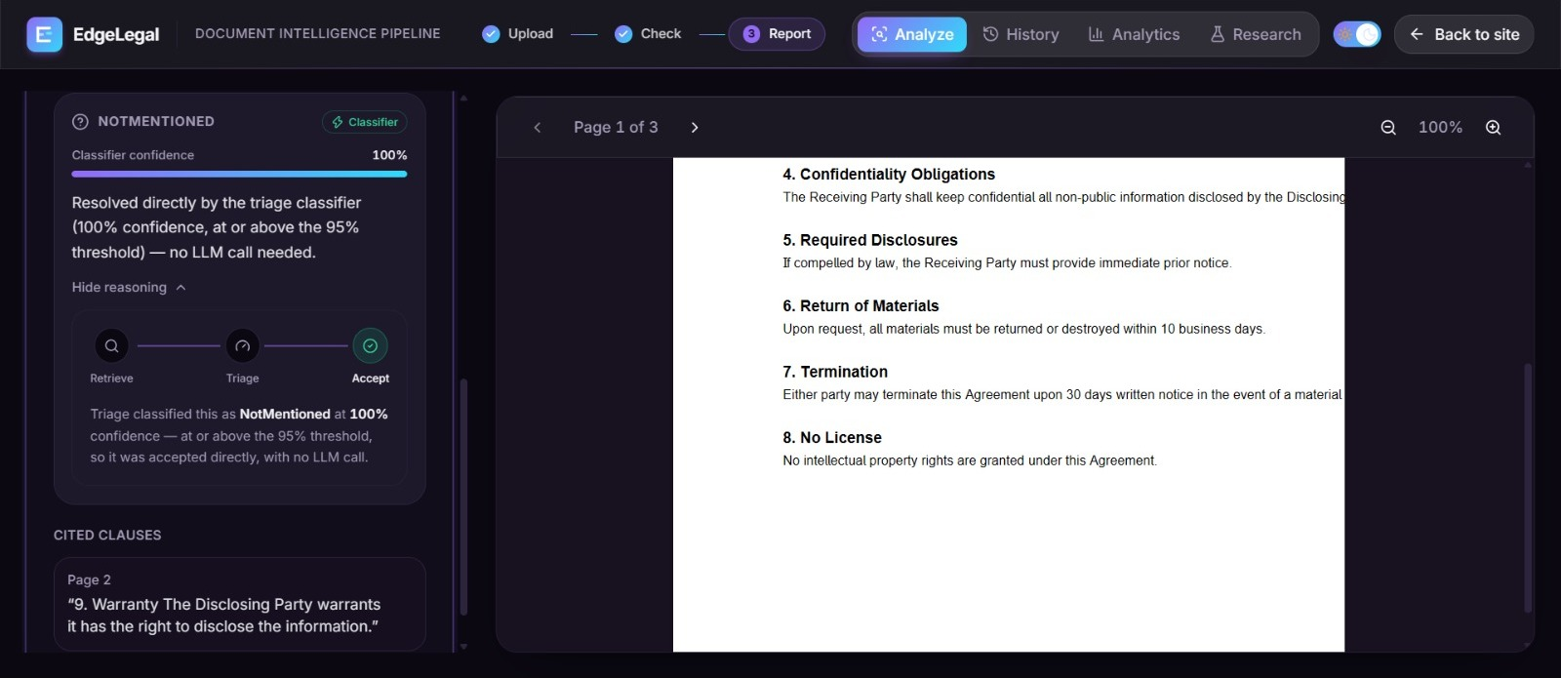
Interface & UI/UX (2/3)
App page
The PDF is uploaded on the left and shown on the right with page and zoom controls.
The user can pick from the standard NDA questions or type a custom one.
Each result shows the label, the classifier confidence and which engine answered (classifier or LLM).
“Show reasoning” opens the Retrieve, Triage, Accept steps, and below it is the cited clause with its page number.
App page: contract uploaded, questions to check
Result for one question

Slide 9
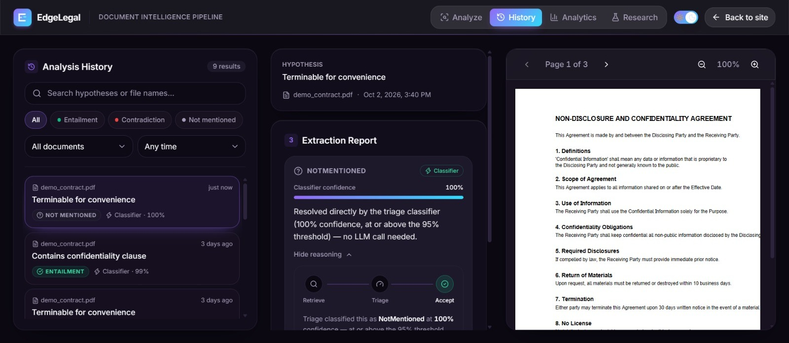
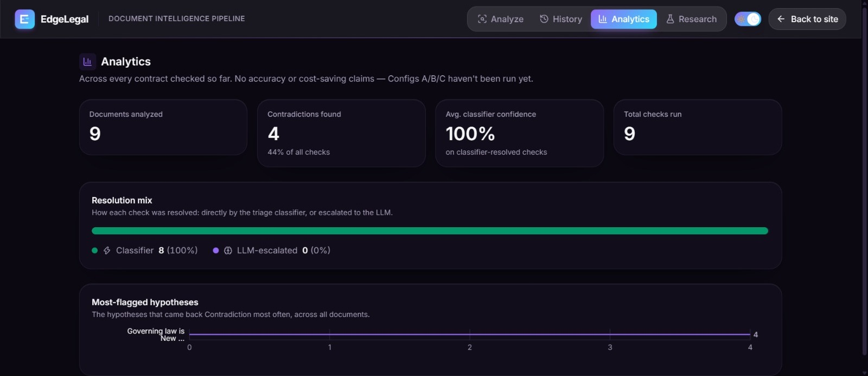
Interface & UI/UX (3/3)
History and Analytics
History keeps every check. It can be searched and filtered by label, document and time.
A saved report opens next to its PDF, so the answer can be checked against the contract.
Analytics shows documents analyzed, contradictions found, average classifier confidence and how many checks were solved by the classifier or the LLM.
Backend endpoints used: /health, /upload, /analyze, /history, /history/{id}, /analytics, /research/metrics and /documents/{id}/file.
History page
Analytics page

Slide 10
Code Snippets & Key Functions (1/2)
confidence_check_node() - the routing decision
build_graph() - retrieve, triage, route
def confidence_check_node(state):
# ...
confidence = state["triage_confidence"]
threshold = state["threshold"]
decision = "accept" if confidence >= threshold \
else "escalate"
log_step(logger, "route.decision",
doc_id=state.get("document_id", "?"),
confidence=round(confidence, 4),
threshold=threshold, decision=decision)
return {"routing_decision": decision}
graph = StateGraph(AgentState)
# ... add_node for the five nodes
graph.set_entry_point("retrieve")
graph.add_conditional_edges(
"retrieve", _after_retrieve,
{"triage": "triage",
"call_llm": "call_llm"},
)
graph.add_edge("triage", "confidence_check")
graph.add_conditional_edges(
"confidence_check", _route,
{"accept": "accept",
"escalate": "call_llm"},
)
graph.add_edge("accept", END)
graph.add_edge("call_llm", END)
This is the whole routing decision. If the classifier's confidence is at least the threshold (0.95) the answer is accepted, otherwise it is escalated to the LLM. Every decision is also written to the log, which helps a lot when debugging.
This builds the LangGraph flow. Retrieve goes to triage, then to the confidence check, and the check sends the case either to accept or to the LLM. For config A the flow skips triage and goes straight from retrieve to the LLM.
Lines taken from the project; # ... marks lines left out to fit the slide.

Slide 11
Code Snippets & Key Functions (2/2)
gap_filter() - adaptive retrieval cut-off
ece() - expected calibration error
def gap_filter(candidates: list,
gap_threshold: float = GAP_THRESHOLD) -> list:
# ...
kept = [candidates[0]]
best_score = candidates[0][1] # fixed anchor
ceiling = best_score * (1.0 + gap_threshold)
for clause, score in candidates[1:]:
if score <= ceiling:
kept.append((clause, score))
else:
break # outside the band of Rank-1
return kept
def ece(conf, ok, bins=10):
n = len(conf); tot = 0.0
for b in range(bins):
lo, hi = b / bins, (b + 1) / bins
idx = [i for i, c in enumerate(conf)
if (lo < c <= hi) or (b == 0 and c == 0)]
if idx:
acc = sum(ok[i] for i in idx) / len(idx)
avg = sum(conf[i] for i in idx) / len(idx)
tot += len(idx) / n * abs(acc - avg)
return tot
It keeps the best clause and every clause whose distance is within 15% of it, and stops at the first one outside that band. The ceiling is fixed to the best clause, so a slow drift of slightly worse clauses cannot sneak weak clauses in.
The predictions are split into 10 confidence bins. For every bin we compare the average confidence with the real accuracy, and add up the gaps weighted by the size of the bin. This is the number we use to say whether the 0.95 can be trusted.
Lines taken from the project; # ... marks lines left out to fit the slide.

Slide 12
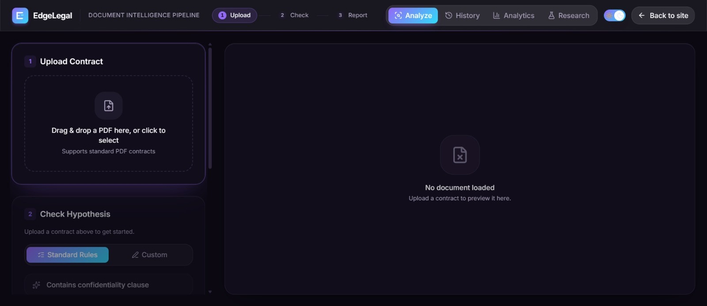
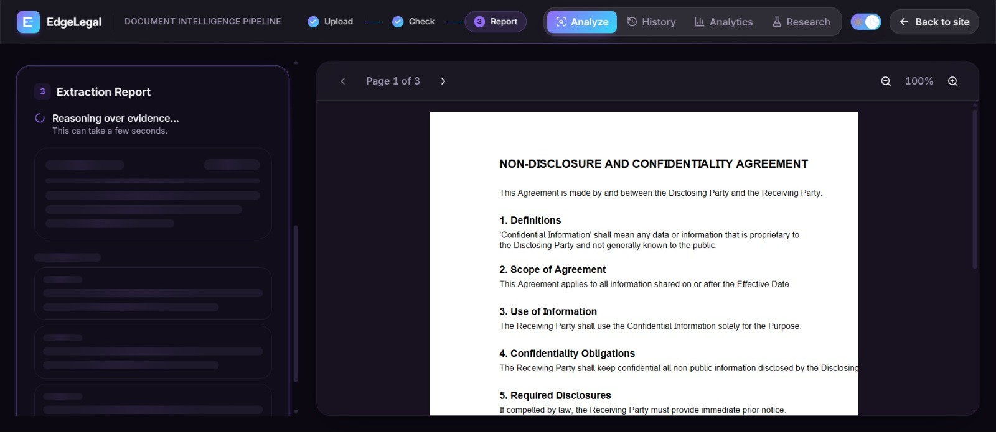
Working Module Demonstration (1/2)
BEFORE
PROCESS
AFTER
Empty app, no contract loaded
Analysis running
Result with confidence and cited clause
What happens in this demo
Before: the app is empty and waits for a contract. The user drops a PDF in the upload box.
Process: the PDF is split into clauses and indexed. For every question the closest clauses are retrieved, DeBERTa classifies them and the router decides if the LLM is needed. The grey loading cards are shown while this runs.
After: the question gets a label and a confidence. This one was settled by the classifier at 100% confidence, so no LLM call was made, and the clause it used is listed below with its page number.

Slide 13
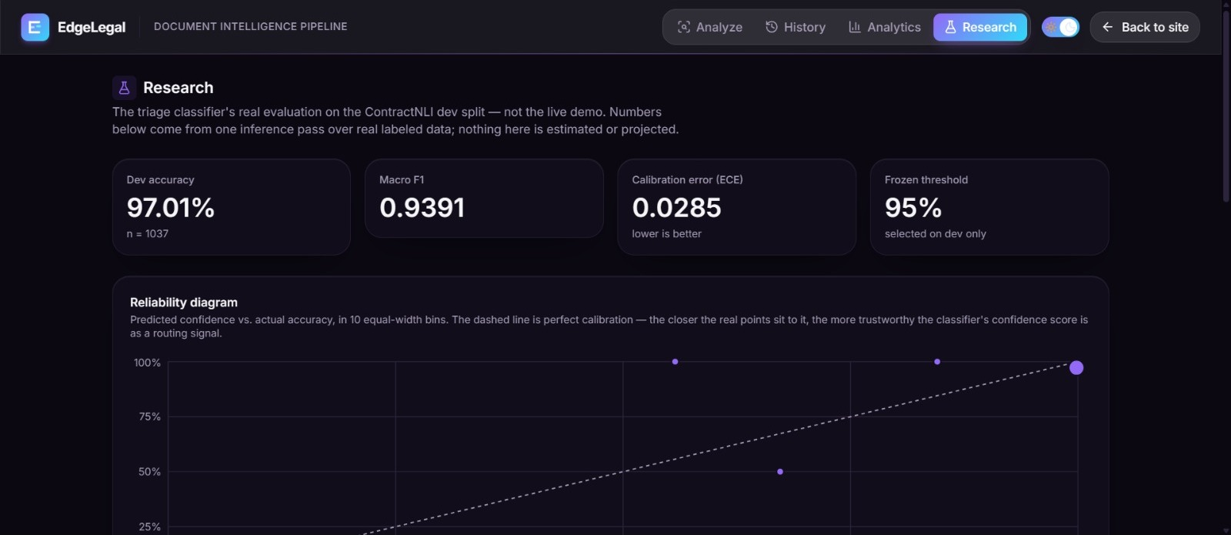
Working Module Demonstration (2/2)
Module output proof
The Research page numbers come from saved result files: dev accuracy 97.01%, macro-F1 0.9391 and ECE 0.0285 on 1,037 examples.
The frozen threshold is 95% and was chosen on the dev set only.
In a live run on 20 documents (340 pairs) the classifier answered 303 pairs and 37 were sent to the LLM.
Research page: results read from saved files
Checks run (2 Oct 2026)
PASS 17 / 17 unit checks
history DB, routing at 0.95, gap
filter, ECE, McNemar, label order
PASS 13 / 13 API checks
health, upload, analyze, history,
analytics, research metrics, CORS
PASS non-PDF upload rejected (400)
PASS 0.9499 escalates, 0.95 accepts
PASS empty database returns zeros
NOTE model, embedder and LLM were
stubbed, so these check the logic
and not the accuracy

Slide 14
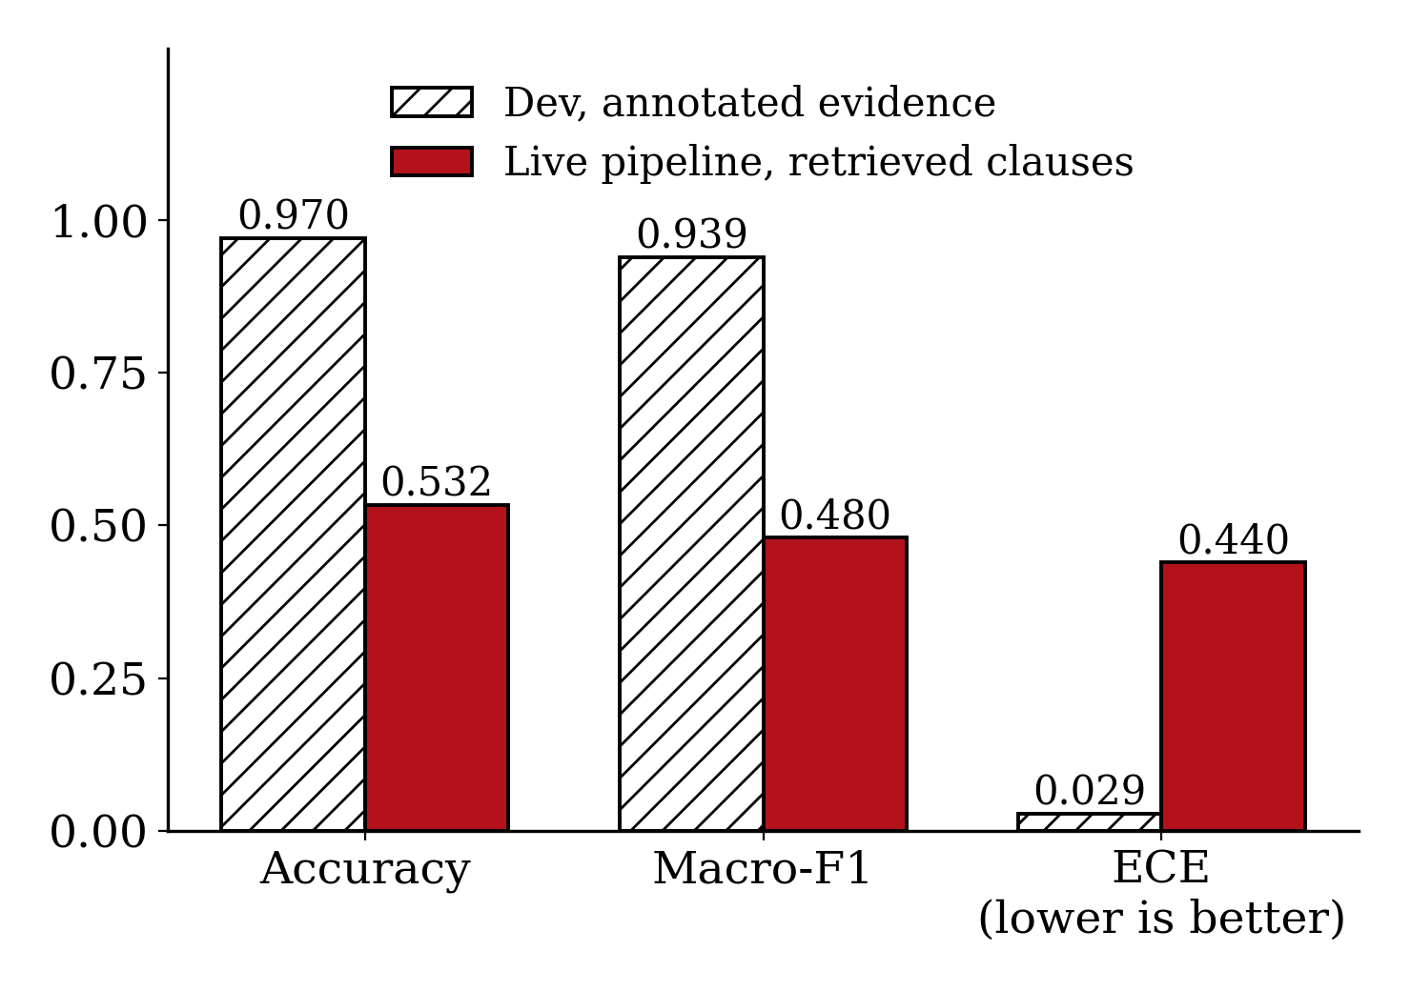
Testing & Preliminary Results
Results so far
Classifier on the dev set (with marked evidence): accuracy 0.9701, macro-F1 0.9391, ECE 0.0285.
F1 per class: Entailment 0.9699, NotMentioned 0.9988, Contradiction 0.8485. Contradiction is the hardest class.
Live pipeline, 20 documents (340 pairs): accuracy 0.5324, macro-F1 0.4796, ECE 0.4396.
The gate accepted 303 pairs (89%) at 0.95 but only 55.1% of them were correct. The 37 sent to the LLM were 37.8% correct.
Small A/B/C run on 34 pairs: A 0.7647 with 34 LLM calls, B 0.5294 with 7, C 0.7647 with 8.
17 / 17 unit checks passed
13 / 13 API checks passed
0 failed
Important observations
The dev numbers are the best case, because the model is given the marked evidence.
The live numbers come from a small 20 document run, not the full 123 test contracts, and the LLM used was the hosted Groq model.
The main finding is over-confidence. In live use the model is very sure but often wrong, so the 0.95 gate lets mistakes pass. We think this is because training and live inputs are different.
The 34 pair A/B/C run is only a trial (2 documents). McNemar p = 0.68 for A vs C and 0.013 for A vs B. The full matched run is still to be done.

Slide 15
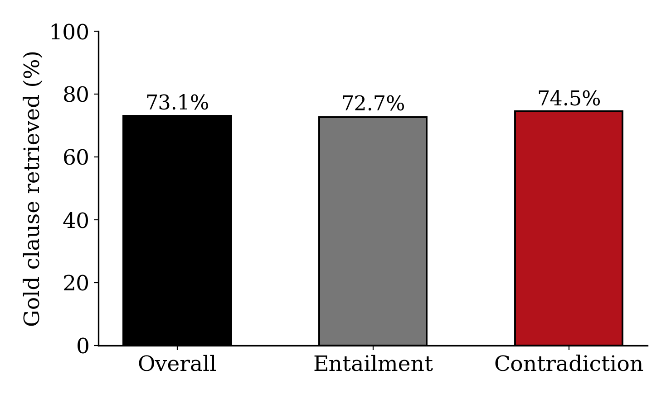
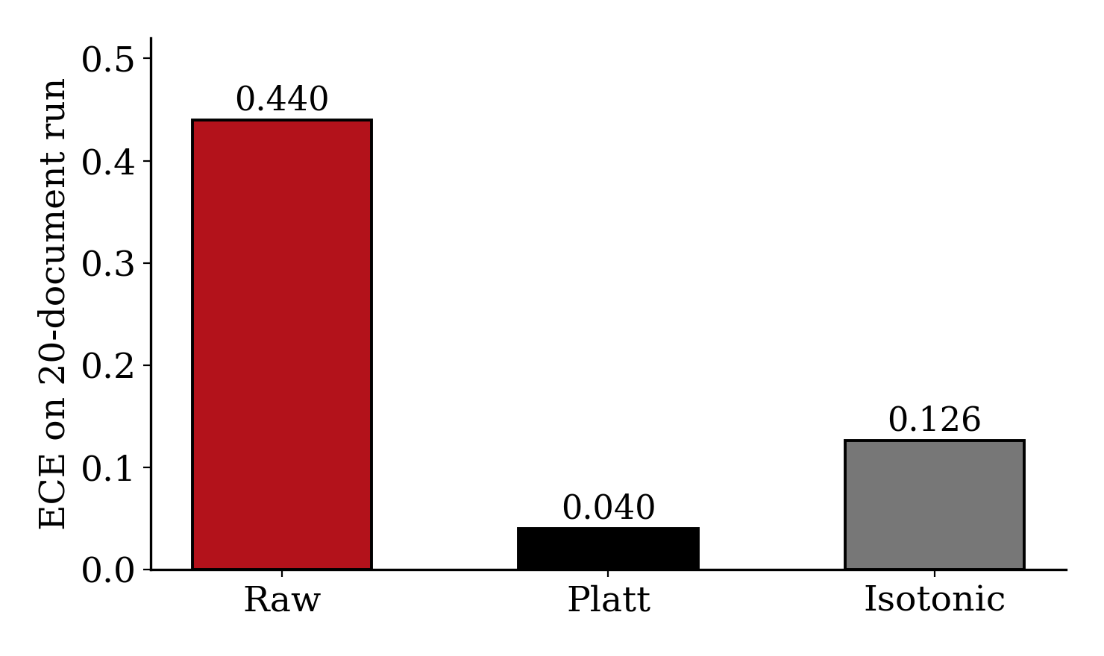
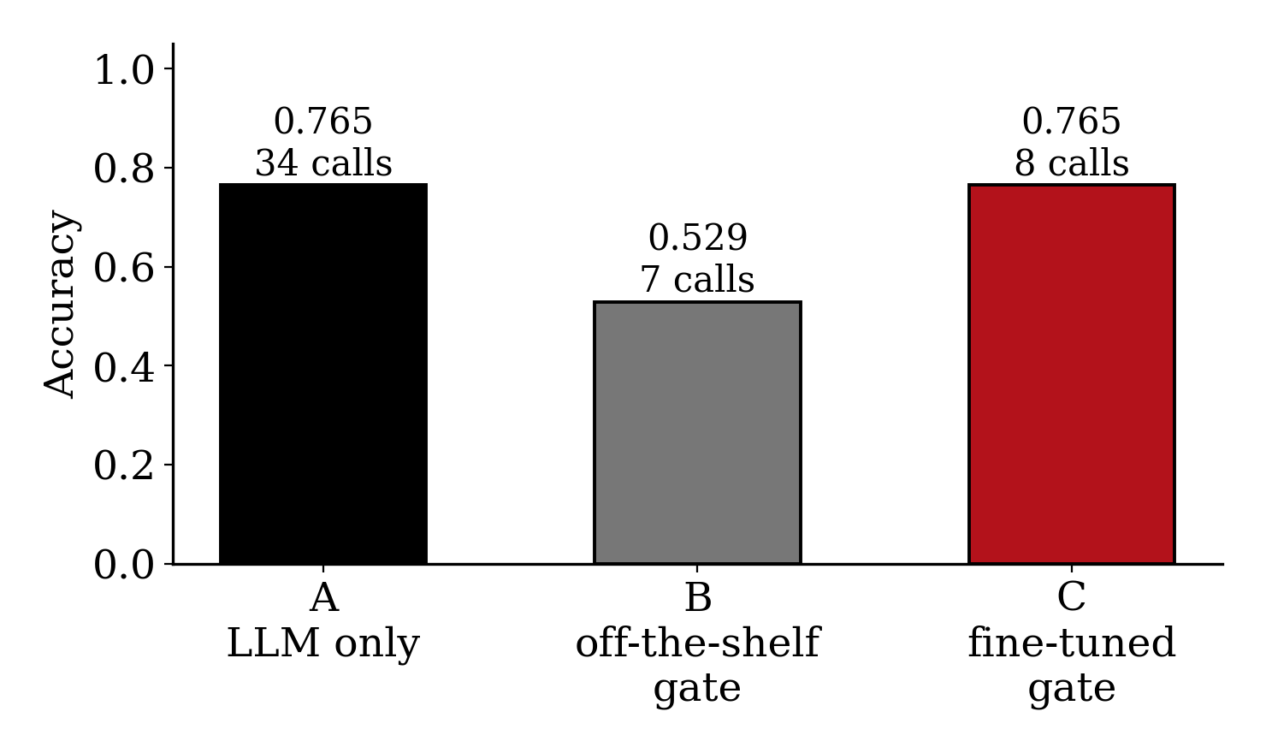
Performance Evaluation (1/2)
Correct clause is retrieved in 73.1% of cases
Recalibration: ECE 0.440 to 0.040 (Platt)
Small run, 34 pairs: accuracy and LLM calls
Retrieval: the marked evidence clause is in the retrieved set for 73.1% of the Entailment and Contradiction cases. The classifier can only use the clauses it receives, so this limits the live accuracy on those classes.
Recalibration: Platt scaling brings the ECE from 0.440 down to 0.040 (isotonic 0.126), but it was fitted and checked on the same 20 documents, so it looks better than it is. The AUROC of the confidence is only about 0.61, so fixing calibration alone does not make the gate useful. Retraining is needed.
Small A/B/C run: the fine-tuned gate (C) matched the LLM-only run (A) in accuracy with 8 LLM calls instead of 34. It is only 34 pairs, so we take it as a hint and not a result.

Slide 16
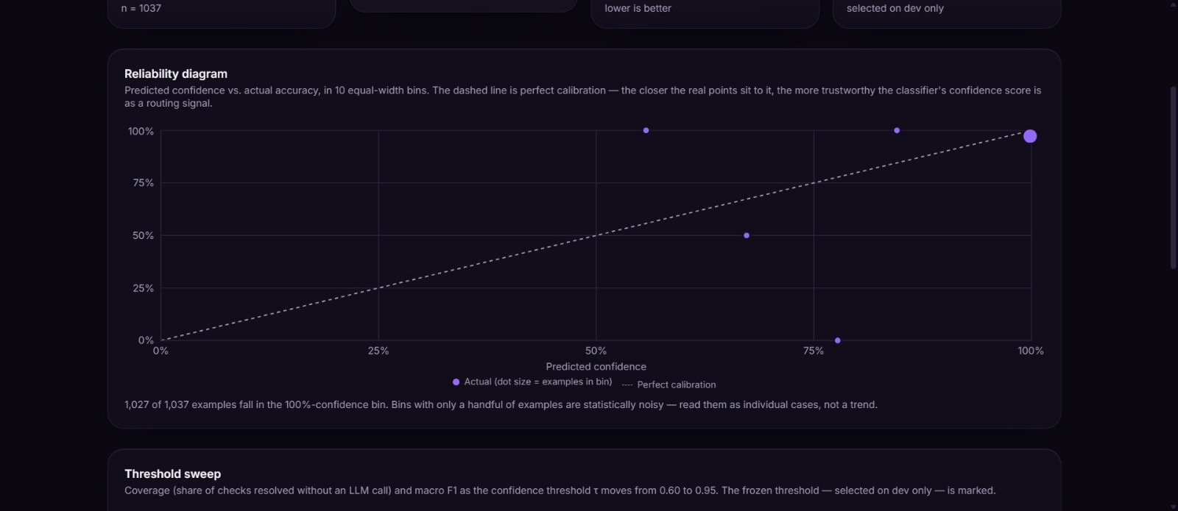
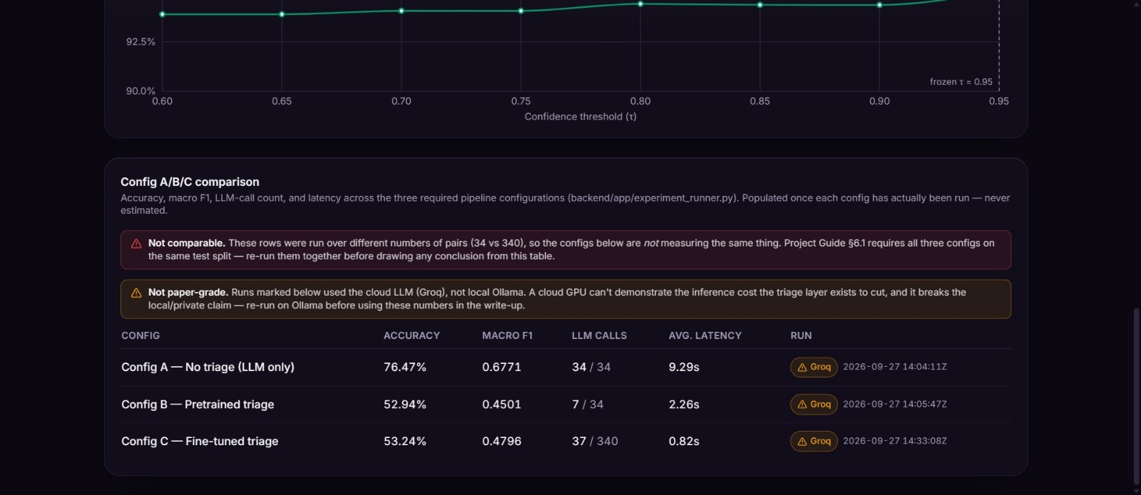
Performance Evaluation & Phase 1 Outcome (2/2)
Reliability diagram on the dev split
A/B/C table saved by the experiment runner
Phase 1 outcome (implemented)
Working app: upload, analyze, history, analytics and research pages.
Classifier: fine-tuned DeBERTa-v3-base with 0.9701 dev accuracy.
Experiments: a runner for configs A, B and C.
Privacy: it is the goal, but the hosted LLM is temporary and the local one comes last.
Measured and not yet measured
Measured: live accuracy 0.5324, ECE 0.4396 and AUROC of confidence 0.61.
Cost: an LLM call is about 1,100 tokens and 98% work on the first try.
Not done yet: the full A/B/C run on all 123 test contracts with a local LLM.
Next: retrain on realistic inputs and repeat the comparison.

